Slide 1
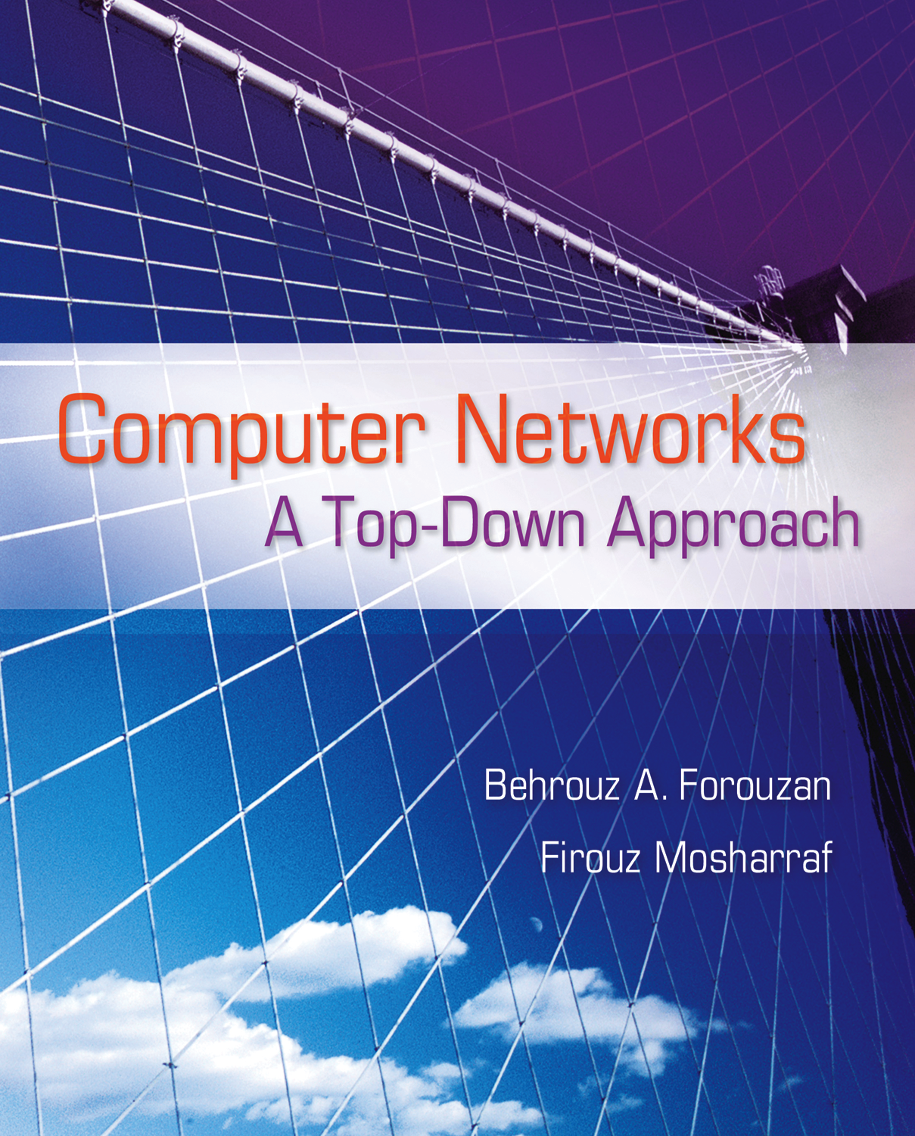
Chapter 1
Introduction
.
Notes:
‹#›

Slide 2
Chapter 1: Outline
1.1 Overview of the Internet
1.2 Protocol Layering
1.3 Internet History
1.4 Standards and Administration
Notes:
1.#

Slide 3
Chapter 1: Objective
We introduce local area networks (LANs) and wide area networks (WANs) and show that an internet or the Internet is a combination of these networks.
We introduce the concept of protocol layering to show how the task to be done by the Internet is divided into smaller tasks. We also discuss TCP/IP protocol suite and show the duty of each layer.
We give a brief history of the Internet.
We introduce the administration of the Internet and define the standards and their lifetime.
Notes:
1.#

Slide 4
1-1 OVERVIEW OF THE INTERNET
We start our journey by first defining a network. We then show how we can connect networks to create small internetworks. Finally, we show the structure of the Internet and open the gate to study the Internet in the next ten chapters.
1.‹#›
Notes:
1.#

Slide 5
1.1.1 Networks
A network is the interconnection of a set of devices capable of communication. In this definition, a device can be a host such as a large computer, desktop, laptop, workstation, cellular phone, or security system. A device in this definition can also be a connecting device such as a router a switch, a
modem that changes the form of data, and so on.
1.‹#›
Notes:
1.#

Slide 6
1.1.1 Networks (Continued)
Local Area Networks
Wide Area Networks
Point-to-Point WANs
Switched WANs
Internetwork
1.‹#›
Notes:
1.#

Slide 7
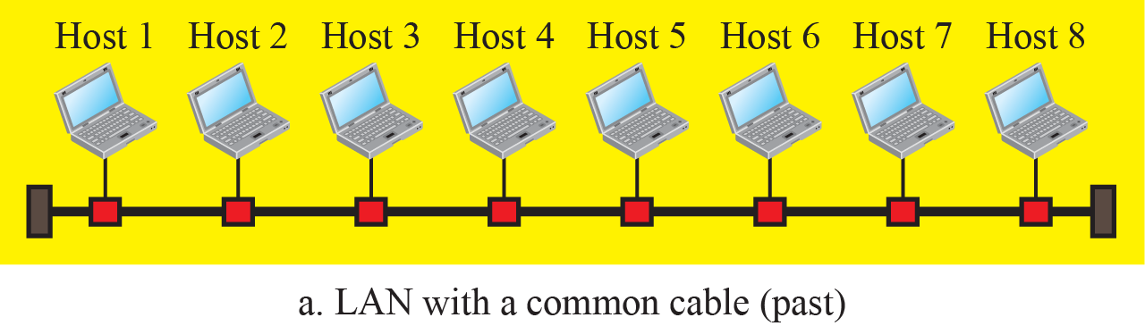
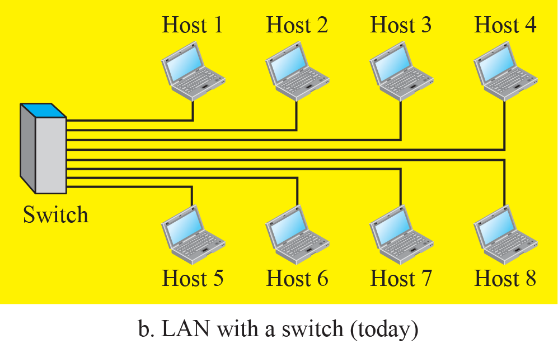
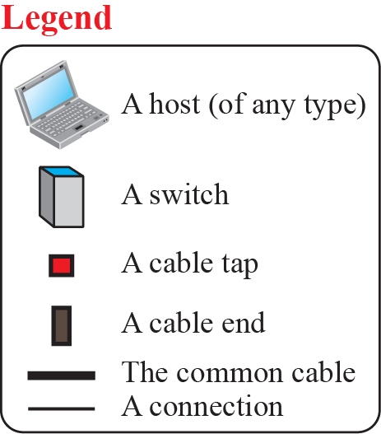
Figure 1.1: An Isolated LAN in the past and today
1.‹#›
Notes:
1.#

Slide 8
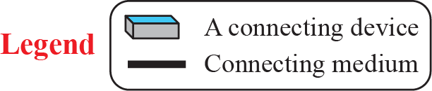
Figure 1.2: A Point-to-Point WAN
1.‹#›
Notes:
1.#

Slide 9
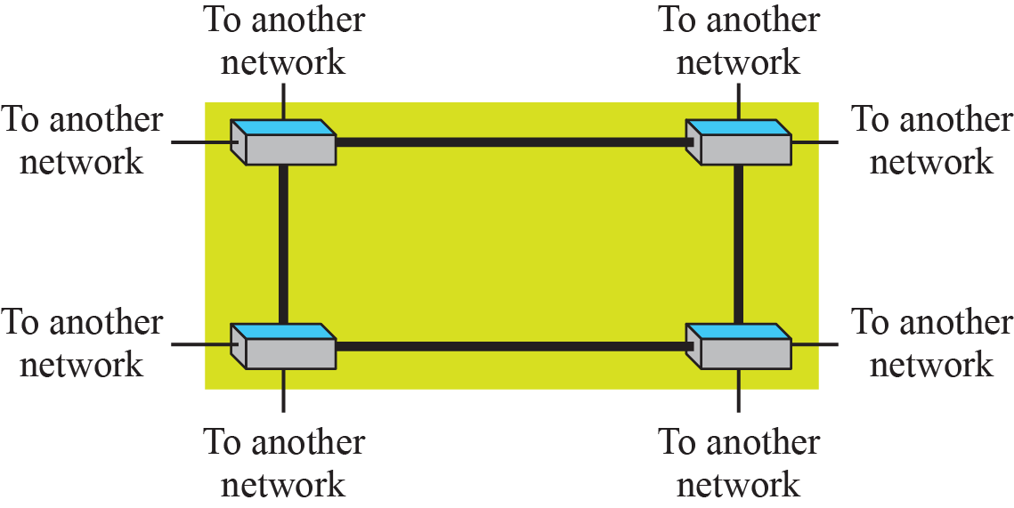
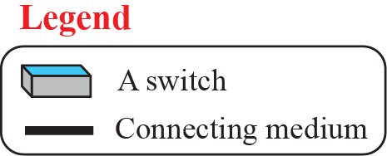
Figure 1.3: A Switched WAN
1.‹#›
Notes:
1.#

Slide 10
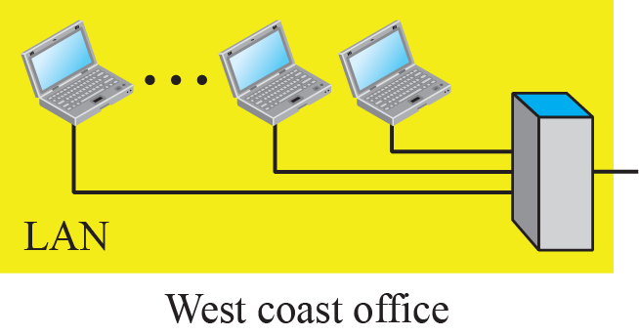
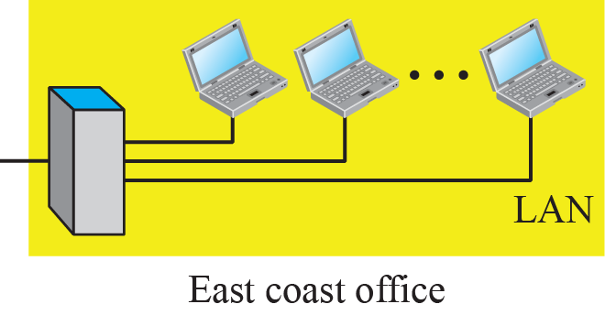
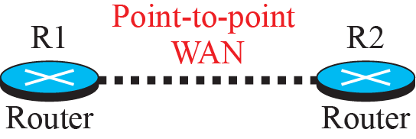
Figure 1.4: An internetwork made of two LANs and one WAN
1.‹#›
Notes:
1.#

Slide 11

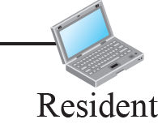
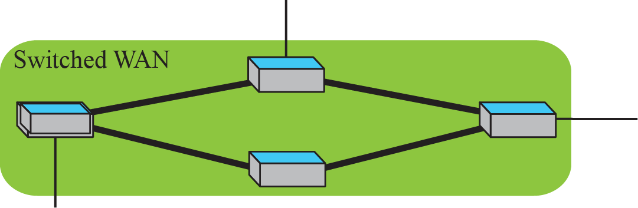
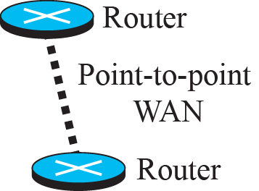
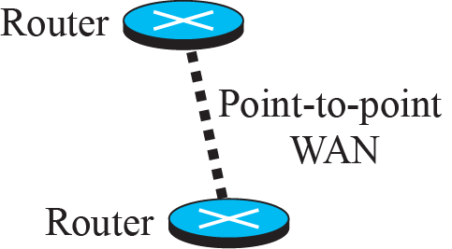
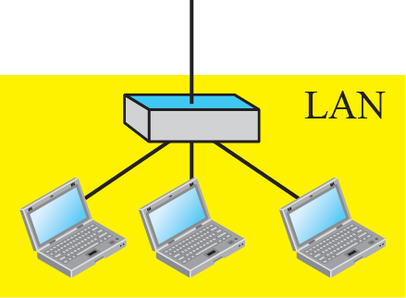
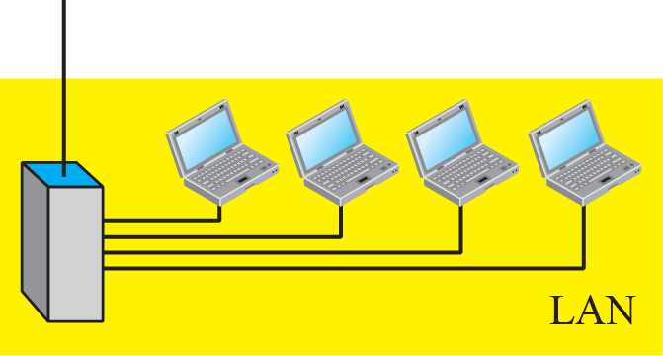
Figure 1.5: A heterogeneous network made of WANs and LANs
1.‹#›
Notes:
1.#

Slide 12
1.1.2 Switching
An internet is a switched network in which a switch connects at least two links together. A switch needs to forward data from a link to another link when required.
Circuit-Switched Network
Packet-Switched Network
1.‹#›
Notes:
1.#

Slide 13

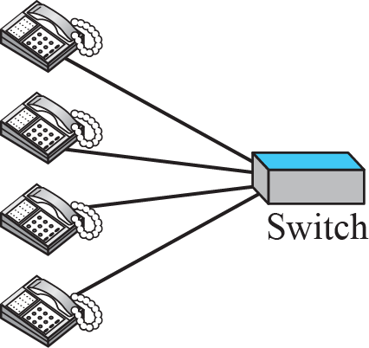
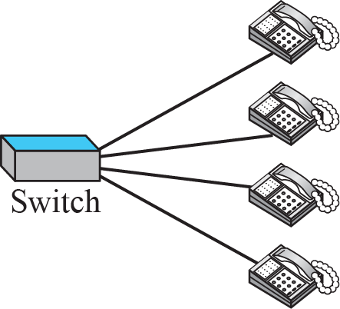
Figure 1.6: A circuit-switched network
1.‹#›
Notes:
1.#

Slide 14

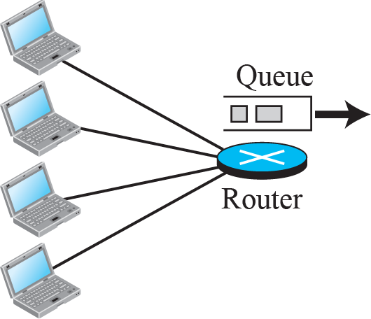
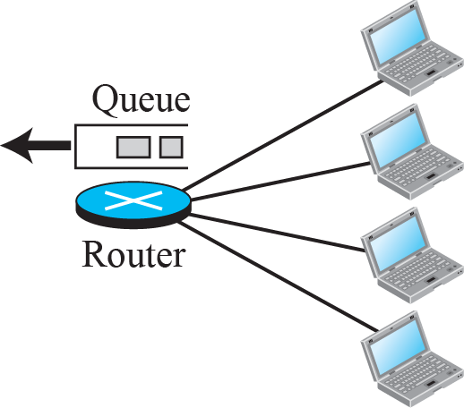
Figure 1.7: A packet-switched network
1.‹#›
Notes:
1.#

Slide 15
1.1.3 The Internet
The most notable internet is called the Internet and is composed of thousands of inter-connected networks. Figure1.8 shows a conceptual (not geographical) view of the Internet.
1.‹#›
Notes:
1.#

Slide 16
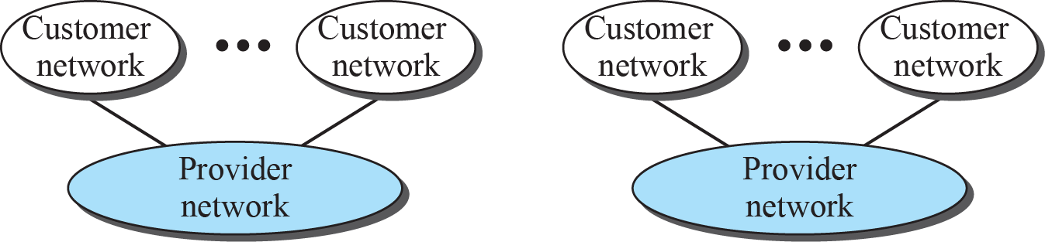
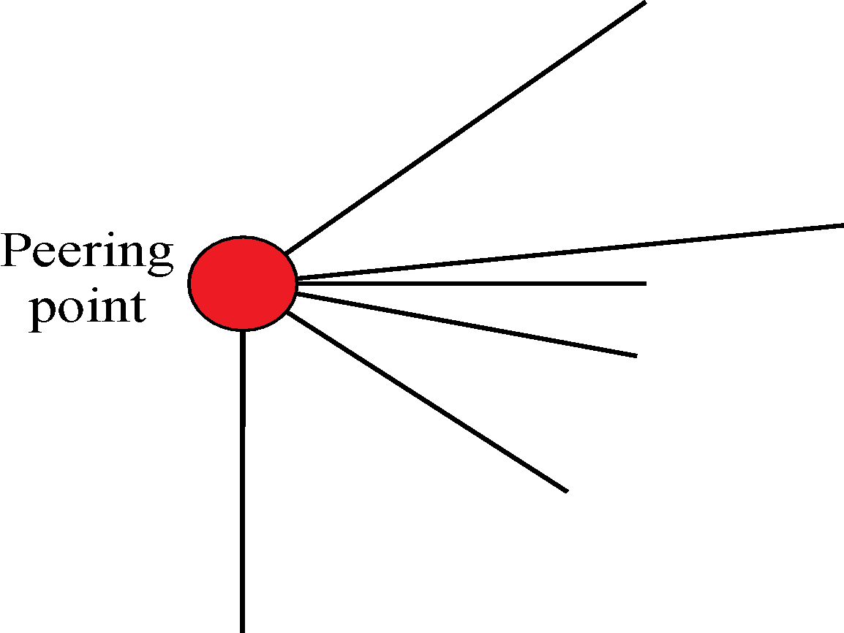

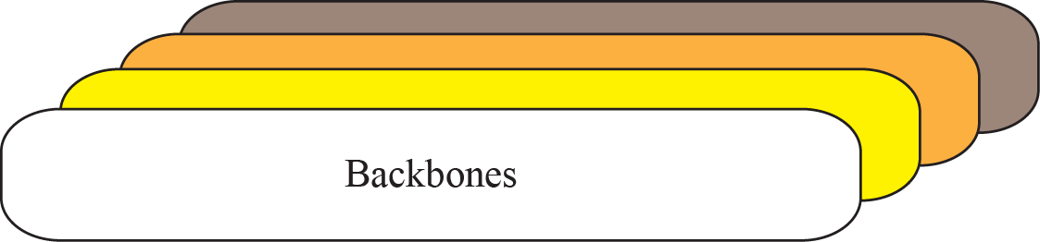
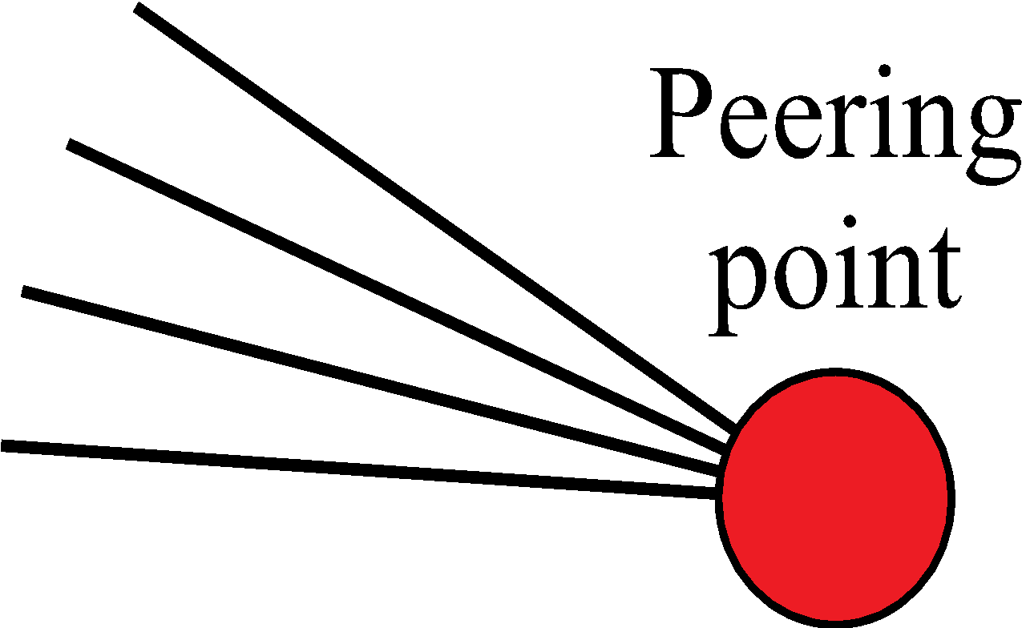

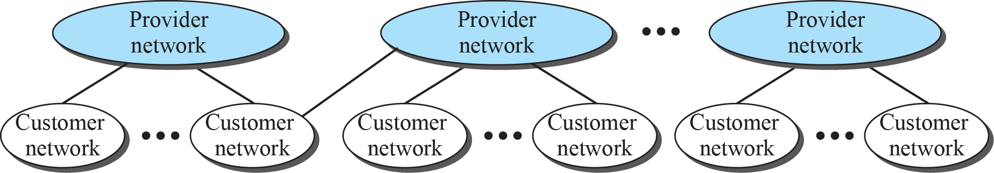
Figure 1.8: The Internet today
1.‹#›
Notes:
1.#

Slide 17
1.1.4 Accessing the Internet
The Internet today is an internetwork that allows any user to become part of it. The user, however, needs to be physically connected to an ISP. The physical connection is normally done through a point-to-point WAN. In this section, we briefly describe how this can happen, but we postpone the technical details of the connection until Chapters 6 and 7.
1.‹#›
Notes:
1.#

Slide 18
1.1.4 Accessing the Internet (continued)
Using Telephone Networks
Dial-up Service
DSL
Using Cable Networks
Using Wireless Networks
Direct Connection
1.‹#›
Notes:
1.#

Slide 19
1.1.5 Hardware and Software
We have given the overview of the Internet structure. For communication to happen, we need both hardware and software. This is similar to a complex computation in which we need both a computer and a program. In the next section, we show how these combinations of hardware and software are coordinated with each other using protocol layering.
1.‹#›
Notes:
1.#

Slide 20
1-2 PROTOCOL LAYERING
A word we hear all the time when we talk about the Internet is protocol. A protocol defines the rules that both the sender and receiver and all intermediate devices need to follow to be able to communicate effectively. When communication is simple, we may need only one simple protocol; when the communication is complex, we need a protocol at each layer, or protocol layering.
1.‹#›
Notes:
1.#

Slide 21
1.2.1 Scenarios
Let us develop two simple scenarios to better understand the need for protocol layering.
First Scenario (Figure 1.9)
Second Scenario (Figure 1.10)
Principle of Protocol Layering
Logical Connections
1.‹#›
Notes:
1.#

Slide 22
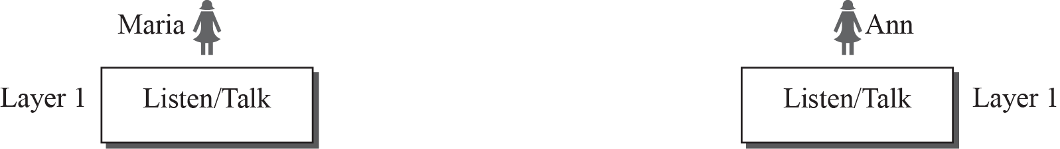
Figure 1.9: A single-layer protocol
1.‹#›
Notes:
1.#

Slide 23
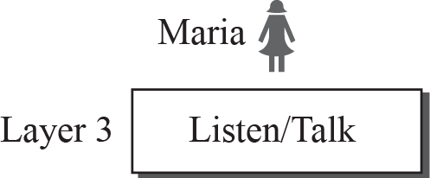
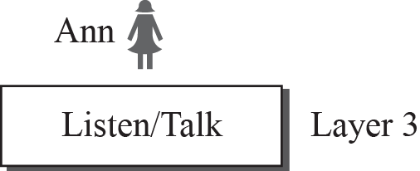
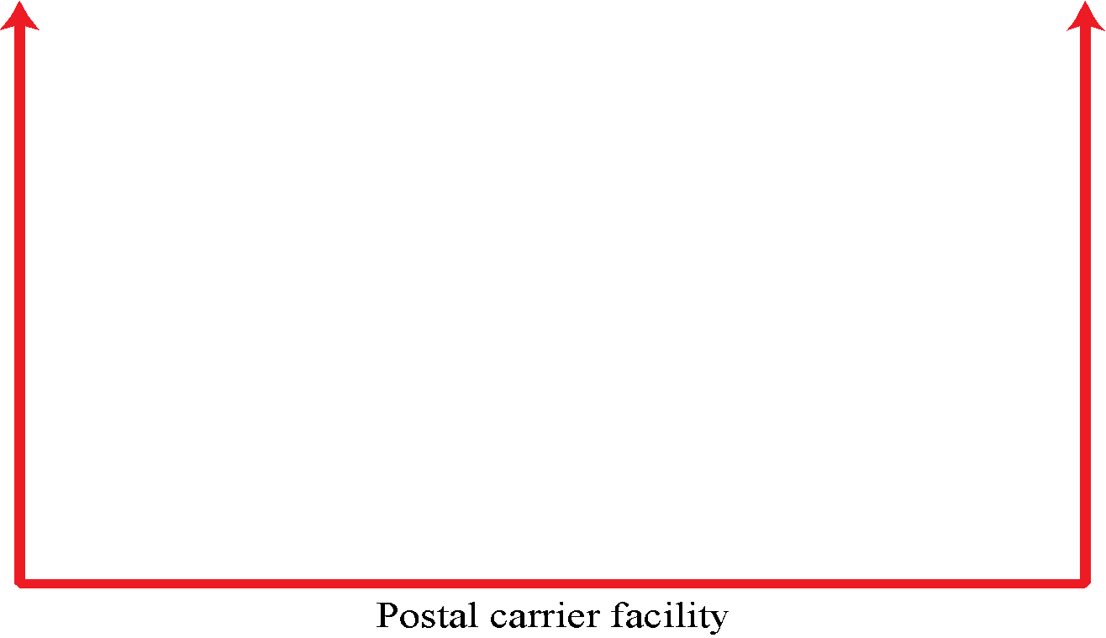



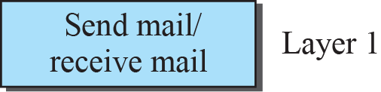
Figure 1.10: A three-layer protocol
1.‹#›
Notes:
1.#

Slide 24
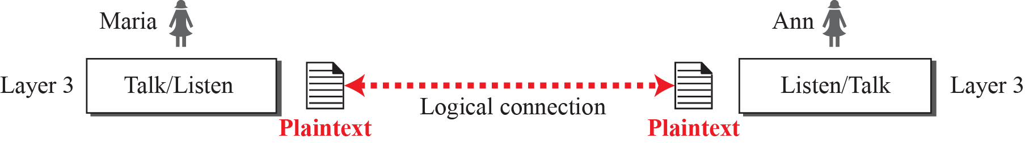
Figure 1.11: Logical connection between peer layers
1.‹#›
Notes:
1.#

Slide 25
1.2.2 TCP/IP Protocol Suite
TCP/IP is a protocol suite used in the Internet today. It is a hierarchical protocol made up of interactive modules, each of which provides a specific functionality. The term hierarchical means that each upper level protocol is supported by the services provided by one or more lower level protocols. The original TCP/IP protocol suite was defined as four software layers built upon the hardware. Today, however, TCP/IP is thought of as a five-layer model.
1.‹#›
Notes:
1.#

Slide 26
1.2.2 TCP/IP Protocol Suite (continued)
Layered Architecture
Layered in the Suite
Description of Each Layer
Application Layer
Transport Layer
Network Layer
Data-link Layer
Physical Layer
1.‹#›
Notes:
1.#

Slide 27
1.2.2 TCP/IP Protocol Suite (continued)
Encapsulation and Decapsulation
Encapsulation at the Source Host
Decapsulation and Encapsulation at Router
Decapsulation at the Destination Host
Addressing
Multiplexing and Demultiplexing
1.‹#›
Notes:
1.#

Slide 28
Figure 1.12: Layers in the TCP/IP protocol suite
1.‹#›
Notes:
1.#

Slide 29
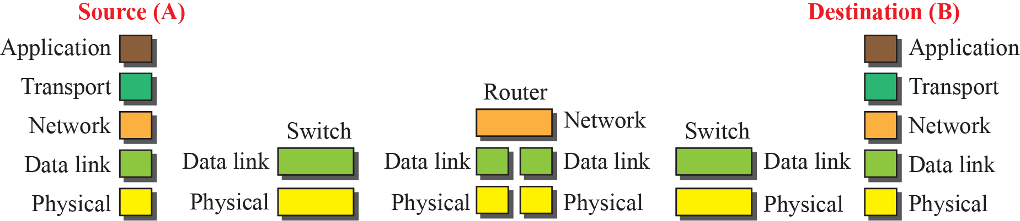

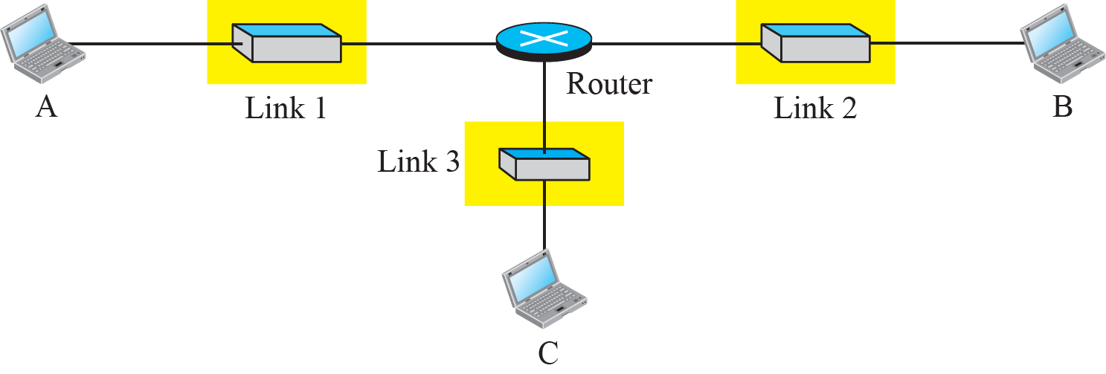
Figure 1.13: Communication through an internet
1.‹#›
Notes:
1.#

Slide 30
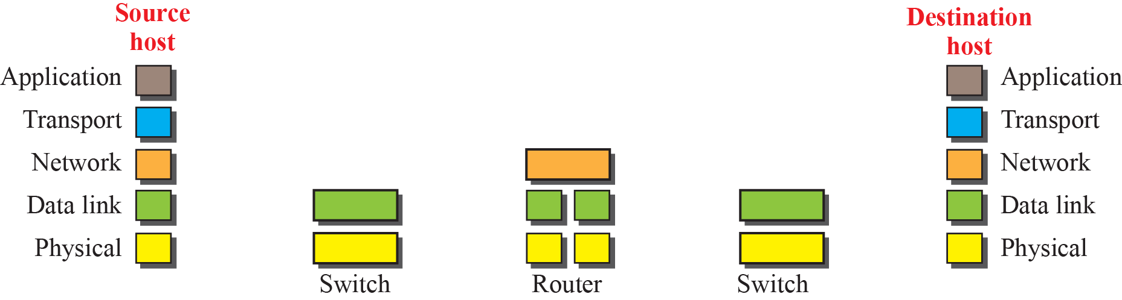
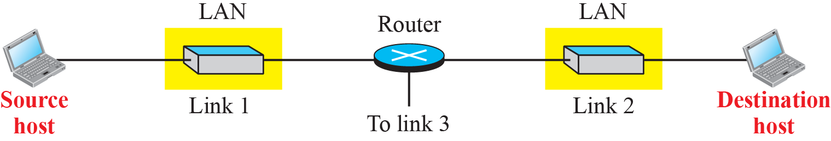
Figure 1.14: Logical connections between layers in TCP/IP
Logical connections
1.‹#›
Notes:
1.#

Slide 31
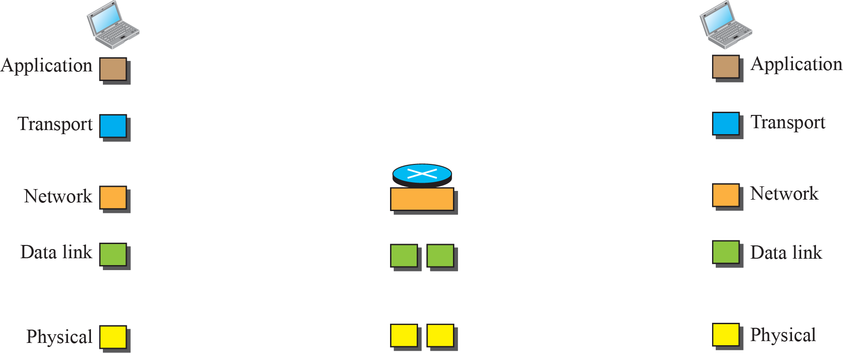
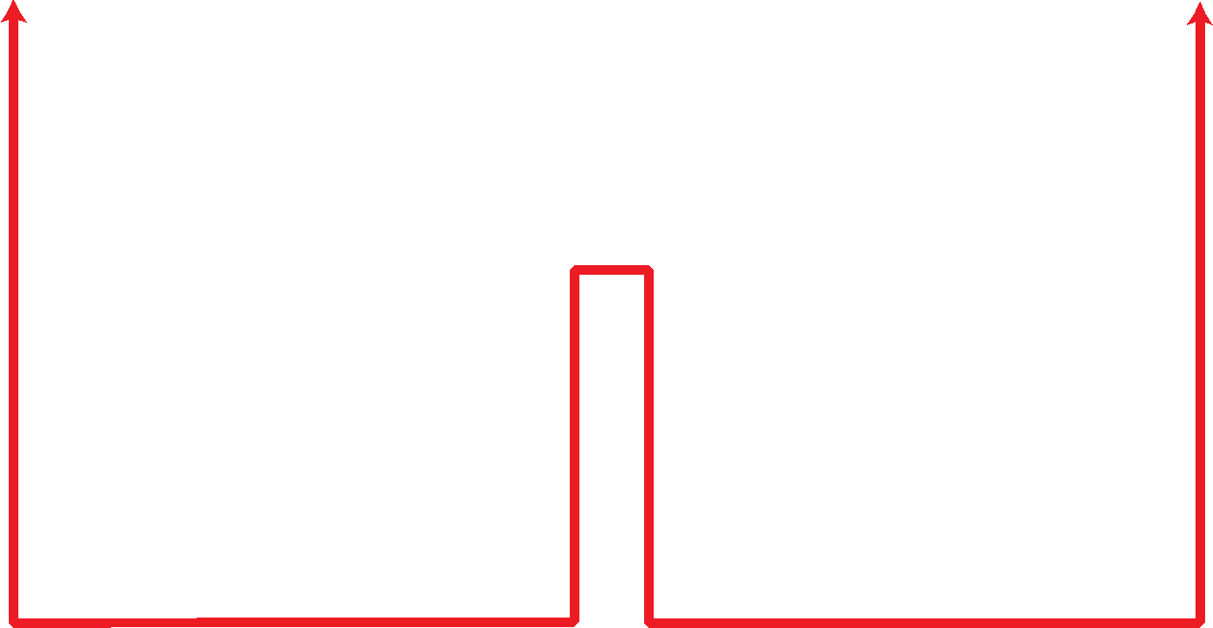
Figure 1.15: Identical objects in the TCP/IP protocol suite
Identical objects (messages)
Identical objects (segment or user datagram)
Identical objects (datagram)
Identical objects (datagram)
Identical objects (frame)
Identical objects (frame)
Identical objects (bits)
Identical objects (bits)
1.‹#›
Notes:
1.#

Slide 32
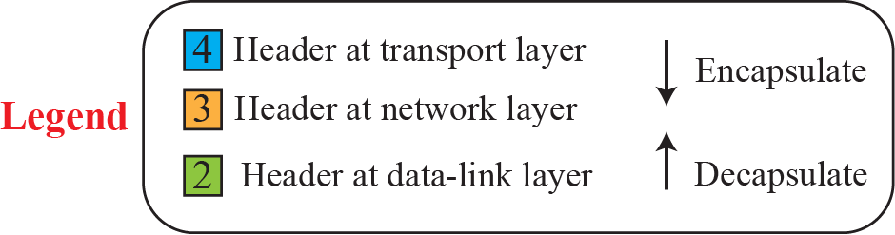
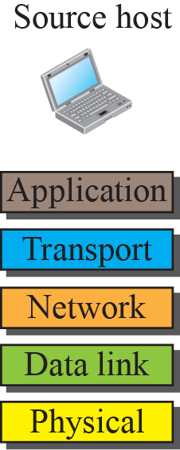
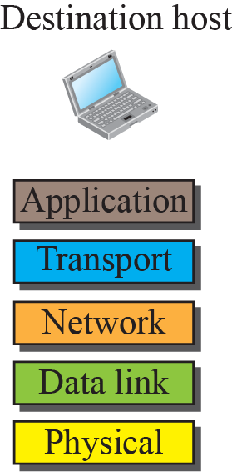

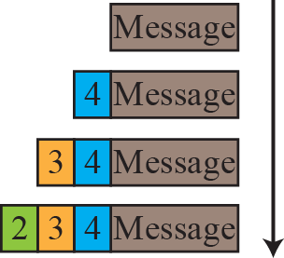
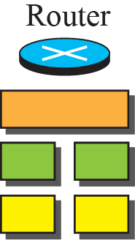
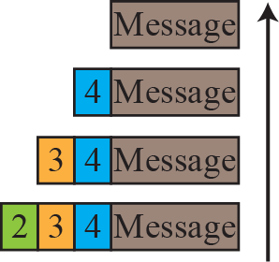
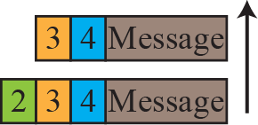
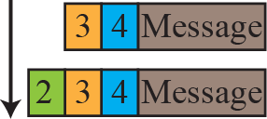
Figure 1.16: Encapsulation / Decapsulation
1.‹#›
Notes:
1.#

Slide 33


Figure 1.17: Addressing in the TCP/IP protocol suite
1.‹#›
Notes:
1.#

Slide 34
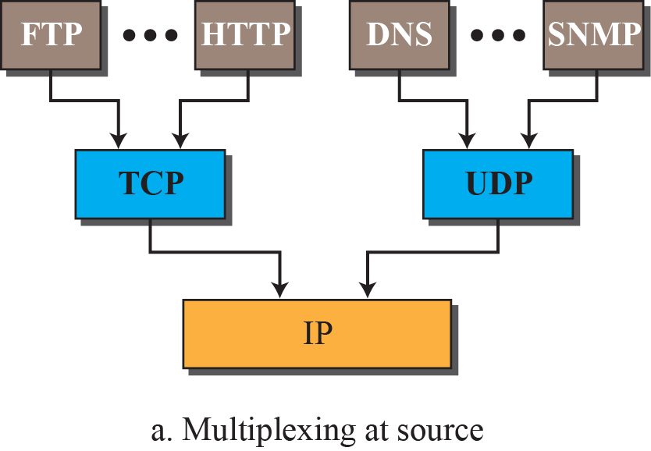
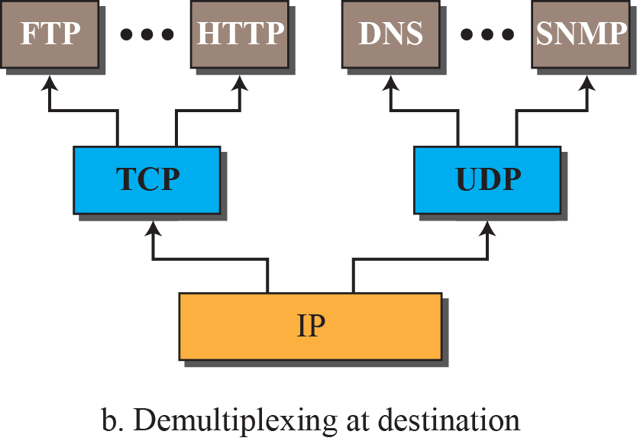
Figure 1.18: Multiplexing and demultiplexing
1.‹#›
Notes:
1.#

Slide 35
1.2.2 The OSI Model
Established in 1947, ISO is a multinational body dedicated to worldwide agreement on international standards. An ISO standard that covers all aspects of network communications is the Open Systems Interconnection (OSI) model. It was first introduced in the late 1970s.
OSI versus TCP/IP
Lack of OSI Model’s Success
1.‹#›
Notes:
1.#

Slide 36
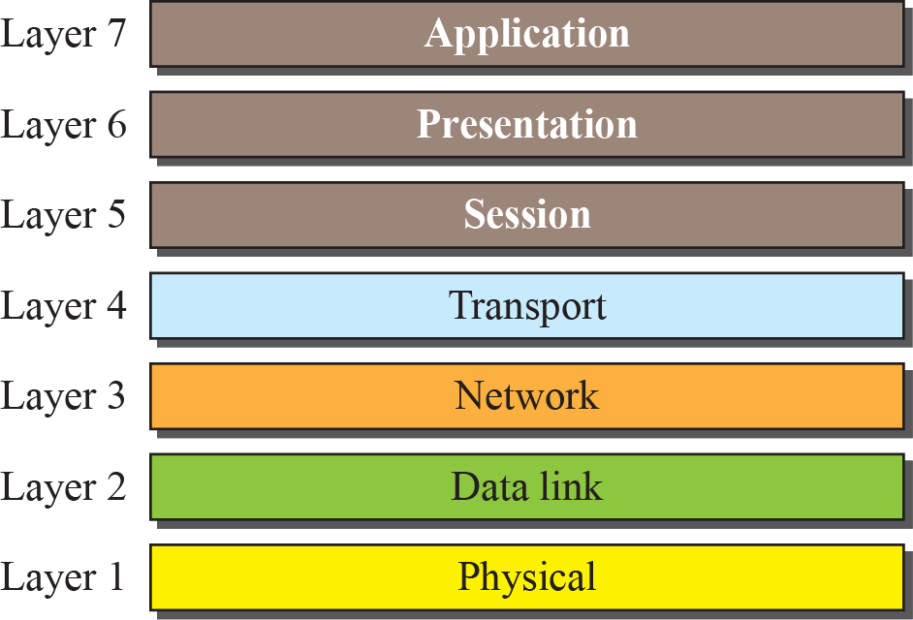
Figure 1.19: The OSI model
1.‹#›
Notes:
1.#

Slide 37
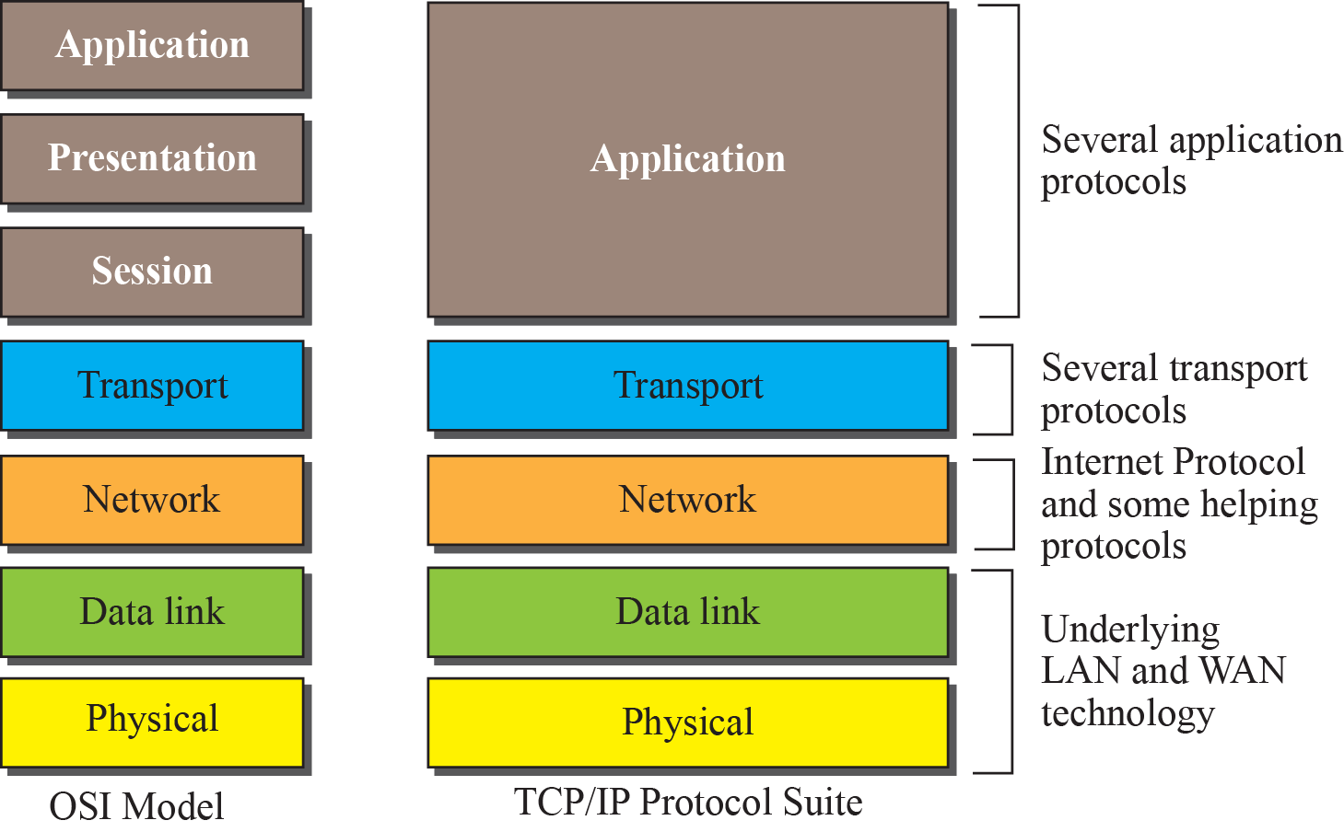
Figure 1.20: TCP/IP and OSI model
1.‹#›
Notes:
1.#

Slide 38
1-3 INTERNET HISTORY
Now that we have given an overview of the Internet and its protocol, let us give a brief history of the Internet. This brief history makes it clear how the Internet has evolved from a private network to a global one in less than forty years.
1.‹#›
Notes:
1.#

Slide 39
1.3.2 Early History
There were some communication networks, such as telegraph and telephone networks, before 1960. These networks were suitable for constant-rate communication at that time, which means that after a connection was made between two users, the encoded message (telegraphy) or voice (telephony) could be exchanged.
Birth of Packet-Switched Networks
ARPANET
1.‹#›
Notes:
1.#

Slide 40
1.3.3 Birth of the Internet
In 1972, Vint Cerf and Bob Kahn, both of whom were part of the core ARPANET group, collaborated on what they called the Internetting Project. They wanted to link dissimilar networks so that a host on one network could communicate with a host on another. There were many problems to overcome: diverse packet sizes, diverse interfaces, and diverse transmission rates, as well as differing reliability requirements.
1.‹#›
Notes:
1.#

Slide 41
1.3.3 Birth of the Internet (continued)
TCP/IP
MILNET
CSNET
NSFNET
ANSNET
1.‹#›
Notes:
1.#

Slide 42
1.3.3 Internet Today
Today, we witness a rapid growth both in the infrastructure and new applications. The Internet today is a set of pier networks that provide services to the whole world. What has made the Internet so popular is the invention of new applications.
World Wide Web
Multimedia
Peer-to-Peer Applications
Notes:
1.#

Slide 43
1-4 STANDARDS AND ADMINISTRATION
In the discussion of the Internet and its protocol, we often see a reference to a standard or an administration entity. In this section, we introduce these standards and administration entities for those readers that are not familiar with them; the section can be skipped if the reader is familiar with them.
1.‹#›
Notes:
1.#

Slide 44
1.4.1 Internet Standards
An Internet standard is a thoroughly tested specification that is useful to and adhered to by those who work with the Internet. It is a formalized regulation that must be followed. There is a strict procedure by which a specification attains Internet standard status. A specification begins as an Internet draft.
1.‹#›
Notes:
1.#

Slide 45
1.4.1 Internet Standards (Continued)
Maturity Levels
Proposed Standard
Draft Standard
Internet Standard
Historic
Experimental
Informational
1.‹#›
Notes:
1.#

Slide 46
1.4.1 Internet Standards (Continued)
Requirement Levels
Required
Recommended
Elective
Limited Use
Not Recommended
1.‹#›
Notes:
1.#

Slide 47
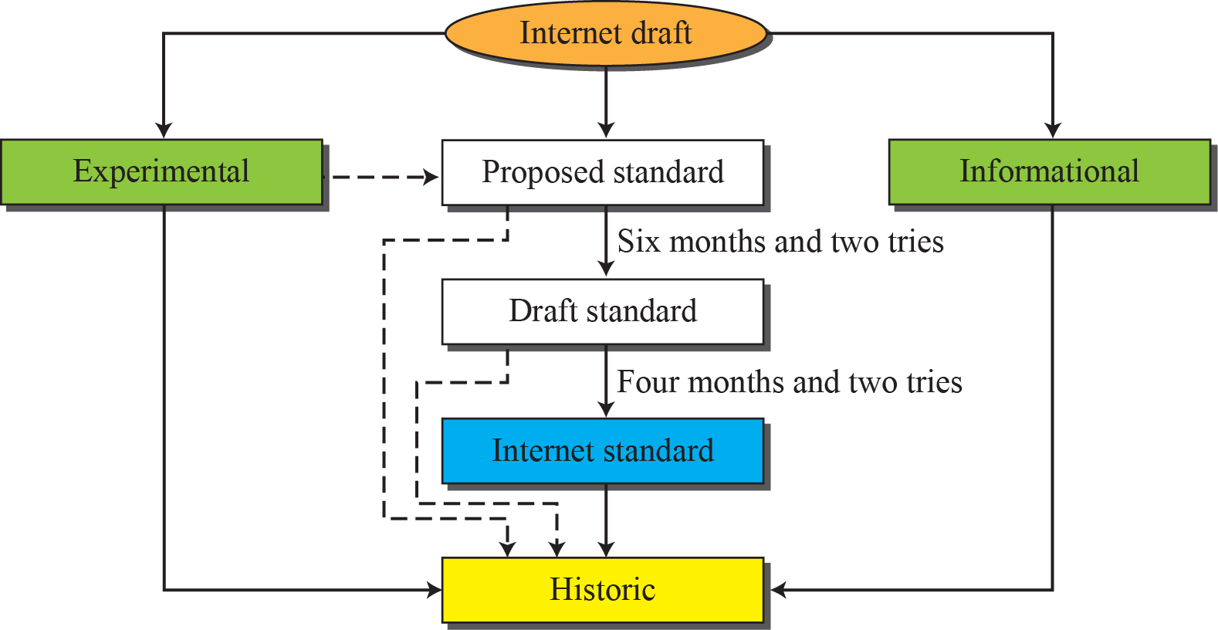
Figure 1.21: Maturity levels of an RFC
1.‹#›
Notes:
1.#

Slide 48
1.4.2 Internet Administration
The Internet, with its roots primarily in the research domain, has evolved and gained a broader user base with significant commercial activity. Various groups that coordinate Internet issues have guided this growth and development. Appendix D gives the addresses, e-mail addresses, and telephone numbers for some of these groups.
1.‹#›
Notes:
1.#

Slide 49
1.4.2 Internet Administration (continued)
ISOC
IAB
IETF
IANA and ICANN
Network Information Center (NIC)
1.‹#›
Notes:
1.#

Slide 50

Figure 1.22: Internet administration
1.‹#›
Notes:
1.#

Slide 51
Chapter 1: Summary (continued)
The history of internetworking started with ARPA in the mid-1960s. The birth of the Internet can be associated with the work of Cerf and Kahn and the invention of a gateway to connect networks. The Internet administration has evolved with the Internet. We discussed ISOC, IAB, IETF, IRTF, ICANN, and NIC.
An Internet standard is a thoroughly tested specification. An Internet draft is a working document with no official status and a six-month lifetime. A draft may be published as a Request for Comment (RFC). RFCs go through maturity levels and are categorized according to their requirement level.
Notes:
1.#

